Slide 1
R Project
By Tim Scherman

Slide 2
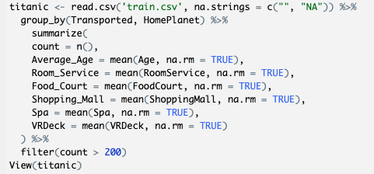
Custom Table
Initially created a custom table grouping by if the passenger was transported or not and which planet they were from
Followed by a count of each and the average age of each subsequent group as well as the average amount of $ the passengers spent on room service, food court, shopping mall, spa, and VR deck

Slide 3
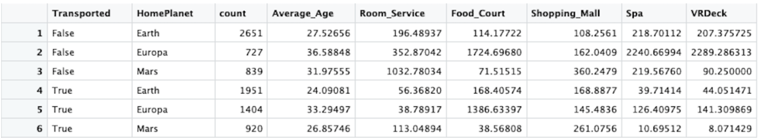
Initial Findings
On average, passengers who were not transported and from Europa spent the most money and were the oldest
Conversely, the youngest group that was transported and from Earth, spent the least amount of money on average

Slide 4
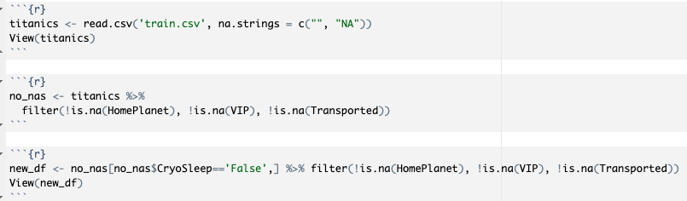
Modifying train.csv File
Made new data frame “titanics” that took any blank cells in the file and put in “NA”
Filtered out NA results from HomePlanet, VIP, and Transported columns
Made another data frame “new_df” that only included passengers who weren’t in Cryo sleep so the graphs I made of how much money each passenger spent would be more accurate and have a bunch of 0’s

Slide 5
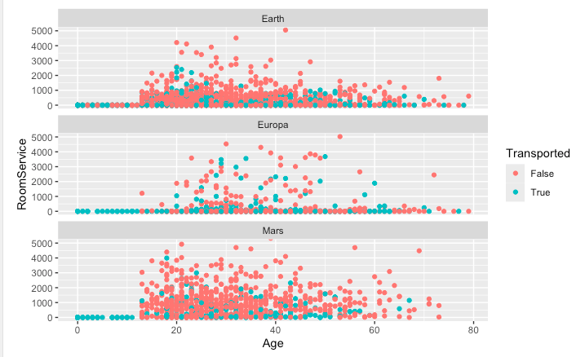
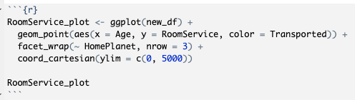
Room Service Plot
Plotted the amount of money each passenger spent on room service vs their age
Filtered by if the passenger was transported or not

Slide 6
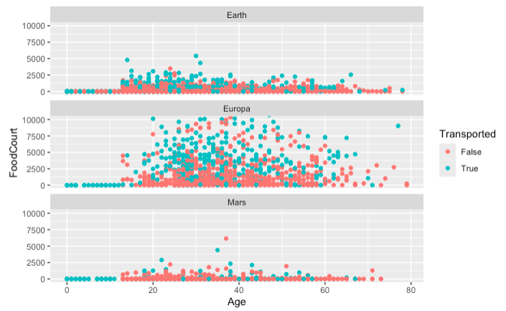
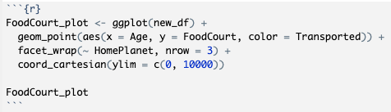
Food Court Plot
Plotted the amount of money each passenger spent on room service vs their age
Filtered by if the passenger was transported or not
Not a lot of people from Mars went to the food court

Slide 7
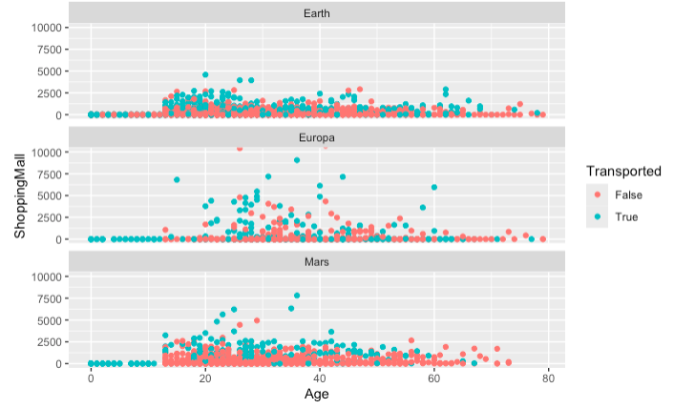
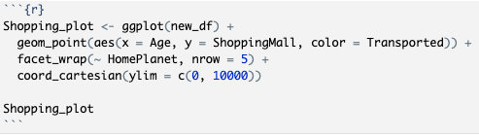
Shopping Plot
Plotted the amount of money each passenger spent on shopping vs their age
Filtered by if the passenger was transported or not
Showing heavier shopping activity with transported passengers

Slide 8
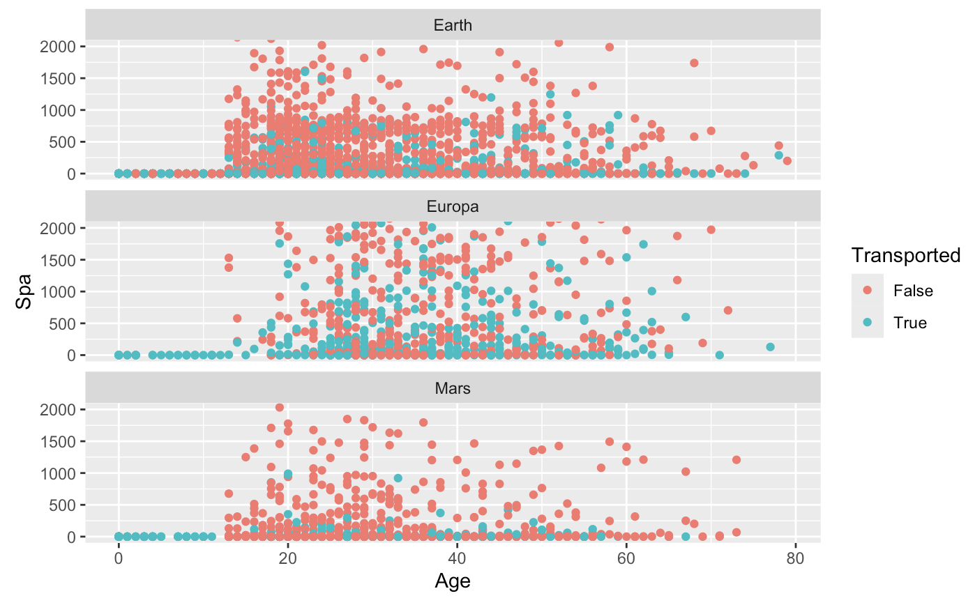
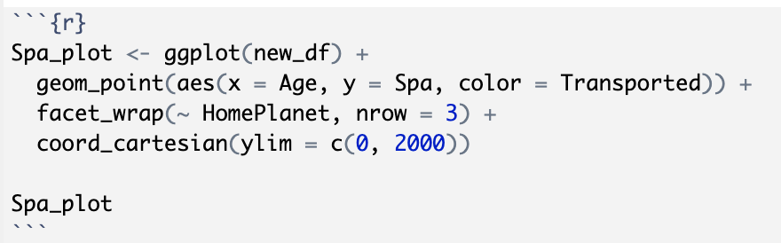
Spa Plot
Plotted the amount of money each passenger spent at the spa vs their age
Filtered by if the passenger was transported or not
Many passengers from Earth who were not transported spent a lot of money at spa

Slide 9
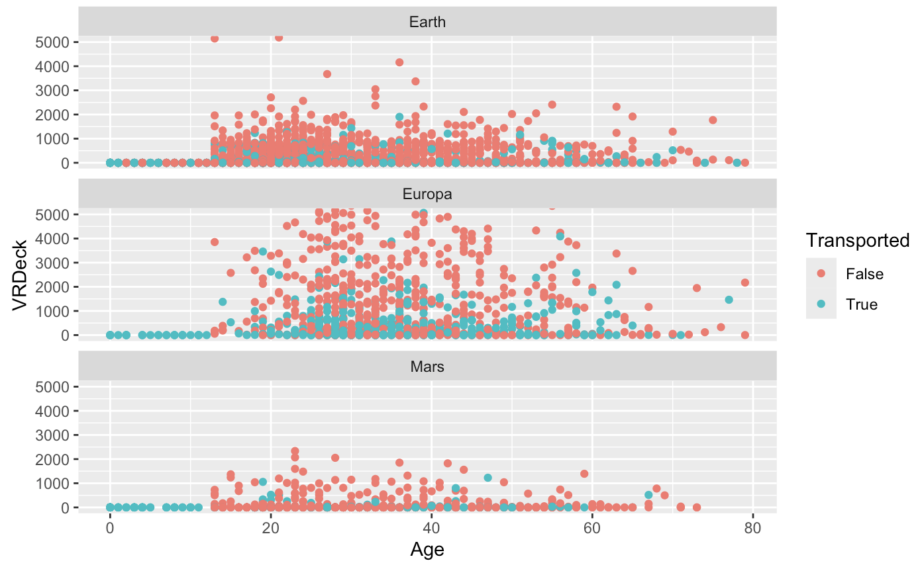
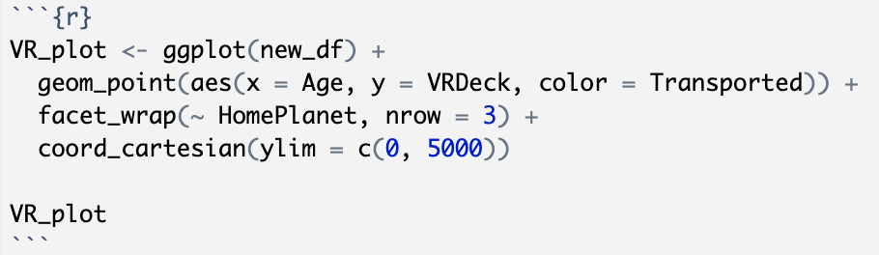
VR Plot
Plotted the amount of money each passenger spent on the VR Deck vs their age
Filtered by if the passenger was transported or not
Many passengers from Earth and Europa who were not transported spent a lot of money at the VR Deck

Slide 10
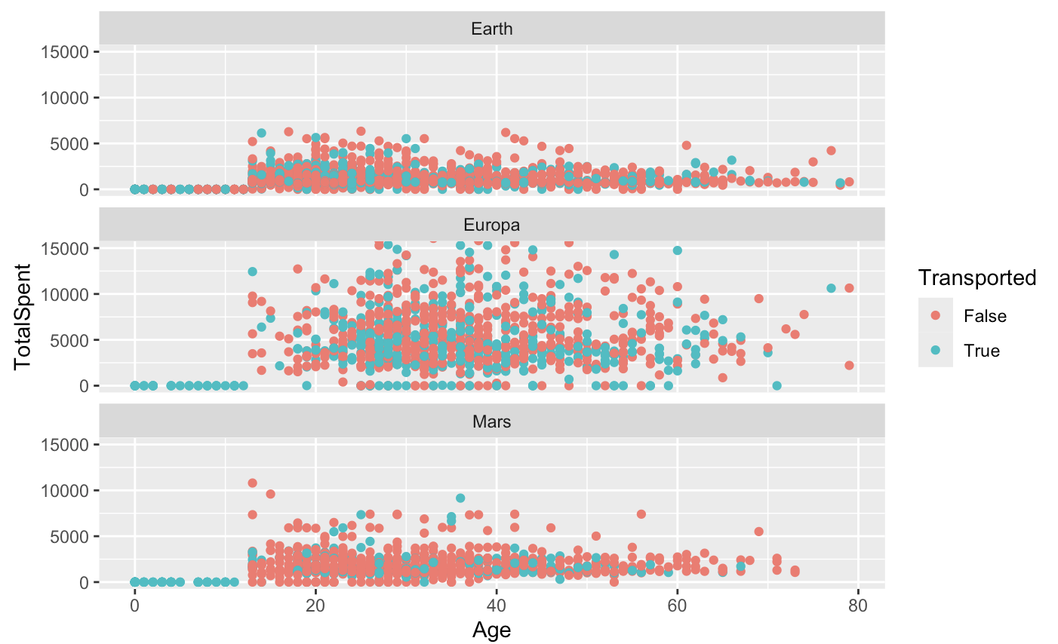
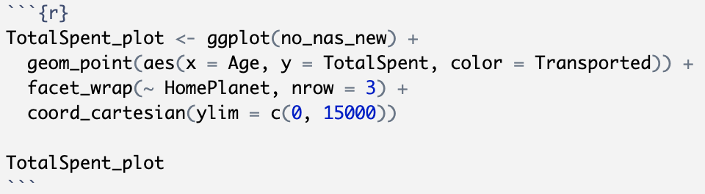
Total Money Spent at All Amenities
Plotted the total amount of money each passenger spent at the amenities vs their age
Filtered by if the passenger was transported or not
Passengers from Earth and Europa who were not transported spent the most amount of money – particularly in Europa

Slide 11
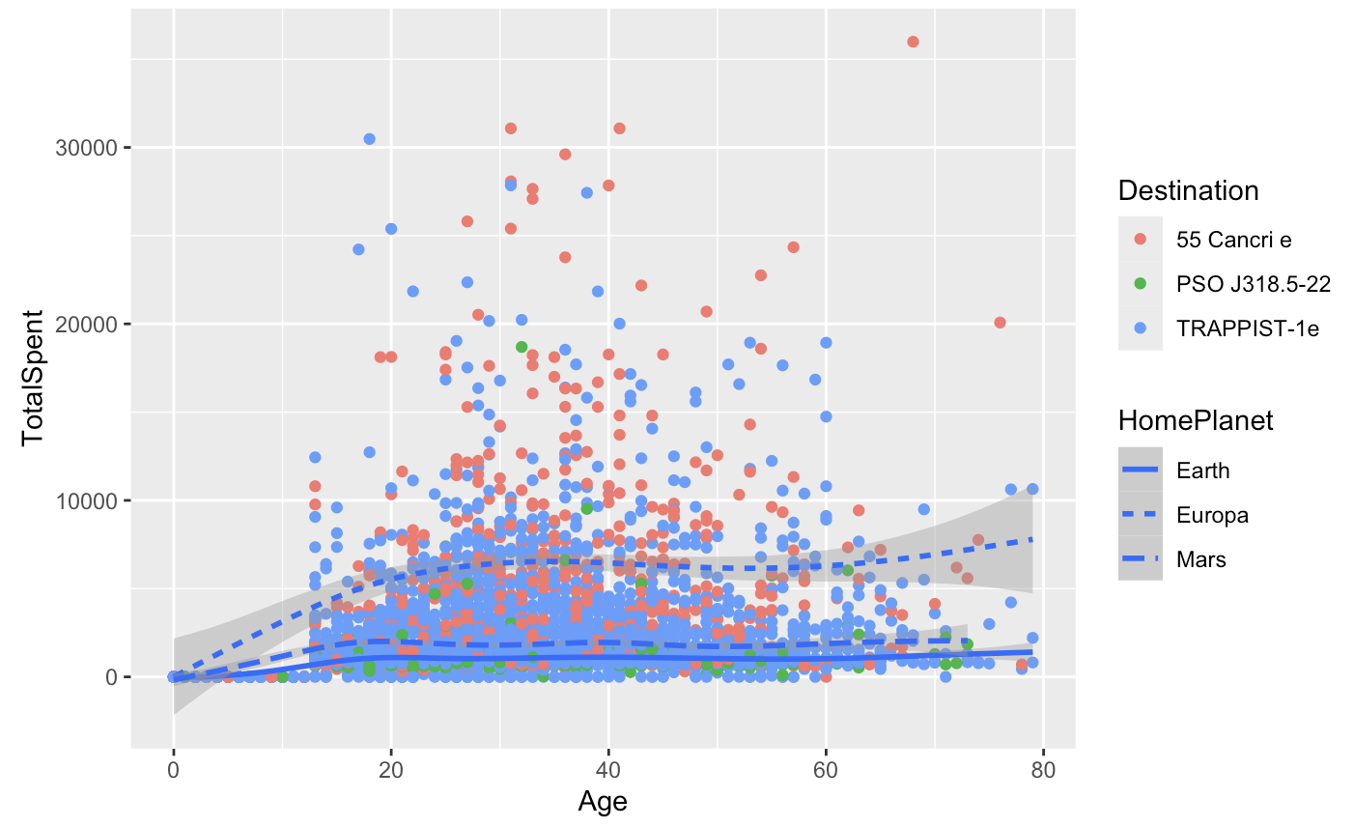
Total Spent vs Age Plot
Plotted another graph showing the total amount of money each passenger spent at the amenities vs their age
Filtered by destination as well as the home planet of the passenger
Most popular destination is TRAPPIST-1e but the most amount of money was spent by people travelling to 55 Cancri e and by passengers who were from Europa

Slide 12
Conclusion
Passengers from Europa spent the most money
The most amount of money was spent at the food court and shopping mall
Passengers not transported spent more money overall at amenities
The most popular destination was TRAPPIST-1e

